Slide 1

吐
臾
一
复
须
线
落

Slide 2

I'm fine
I'm just not happy

Slide 3

Python
网络爬虫与信息提取
『第一周』网络爬虫之规则

Slide 4


Slide 5
Programming Ability Test
Programming Ability Test
Programming Ability Test
Programming Ability Test
Programming Ability Test
Programming Ability Test
PAT(Advanced)模拟篇
Programming Ability Test
Programming Ability Test
Programming Ability Test
Programming Ability Test
Programming Ability Test

Slide 6
Programming Ability Test
Programming Ability Test
Programming Ability Test
Programming Ability Test
Programming Ability Test
Programming Ability Test
PAT(Advanced)查找元素篇
Programming Ability Test
Programming Ability Test
Programming Ability Test
Programming Ability Test
Programming Ability Test

Slide 7
Operating System
Operating System
Operating System
Operating System
Operating System
Operating System
操作系统
作业整理
Operating System
Operating System
Operating System
Operating System
Operating System
Operating System
Operating System
Operating System
Operating System
Operating System
Operating System
Operating System

Slide 8
Operating System
Operating System
Operating System
Operating System
Operating System
Operating System
操作系统
Operating System
Operating System
Operating System
Operating System
Operating System
Operating System
Operating System
Operating System
Operating System
Operating System
Operating System
Operating System

Slide 9

2020.09.07-08
2020.09.07-08
实训日记
实训日记

Slide 10
2020.09.09 星期三
2020.09.09 星期三
实训日记
实训日记

Slide 11
2020.09.29 星期二
2020.09.29 星期二
实训日记
实训日记

Slide 12

2020-09-25
随笔

Slide 13

的的👩‍💻

Slide 14
路漫漫其修远兮，吾将上下而求索

Slide 15

路漫漫其修远兮吾将上下而求索
路漫漫其修远兮吾将上下而求索
Notes:
青年之担当，当毅不为疫

Slide 16
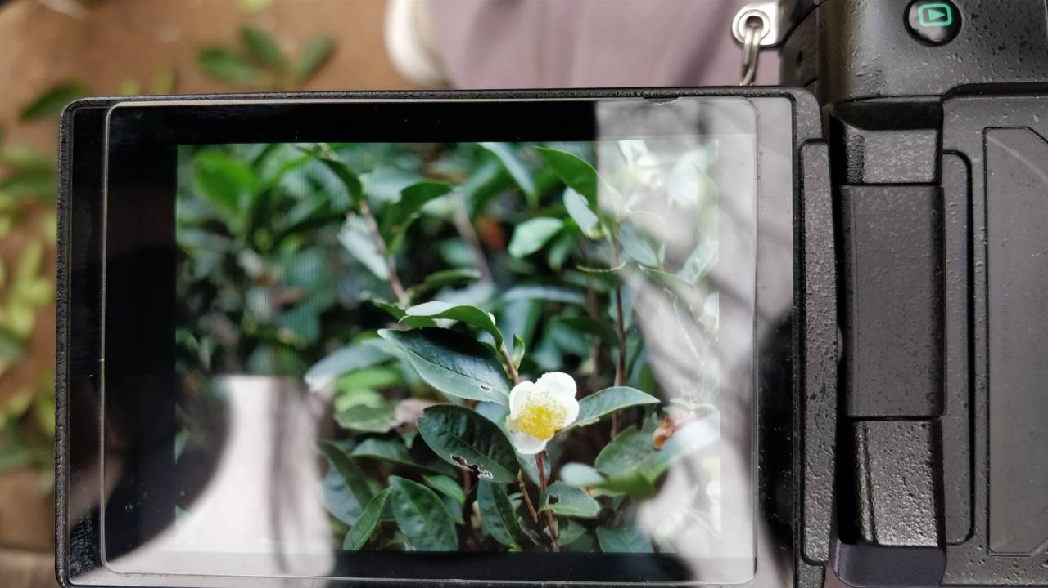
送你一朵
山茶
❀

